Slide 1

Budget Sales Analytics

Slide 2
Introduction
Budget sales analytics is the process of examining a company's cash flow
and comparing it to their budget to determine if they are on track.
The ultimate goal would be to predict sales based on various factor and budget

Slide 3
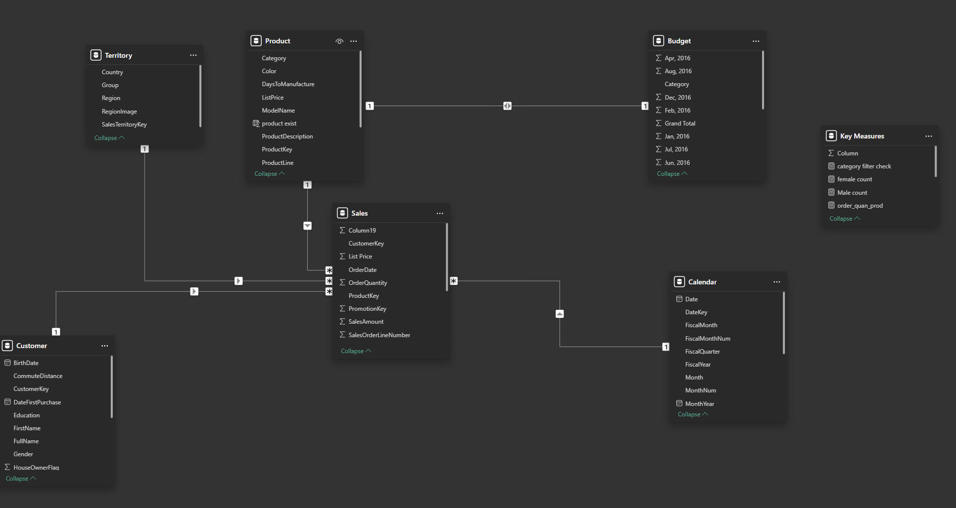
Details of Data

Slide 4
Main kpIs
Overview of different factors like profession/martial status etc that reflects on the sales
Sales record according to the different region.
Product sales according to the product listed
Customer sales gives a proper insights of where the sales should be focused on
Budget Analysis according to Fiscal Quarter / year
Calculating the total profit and loss

Slide 5
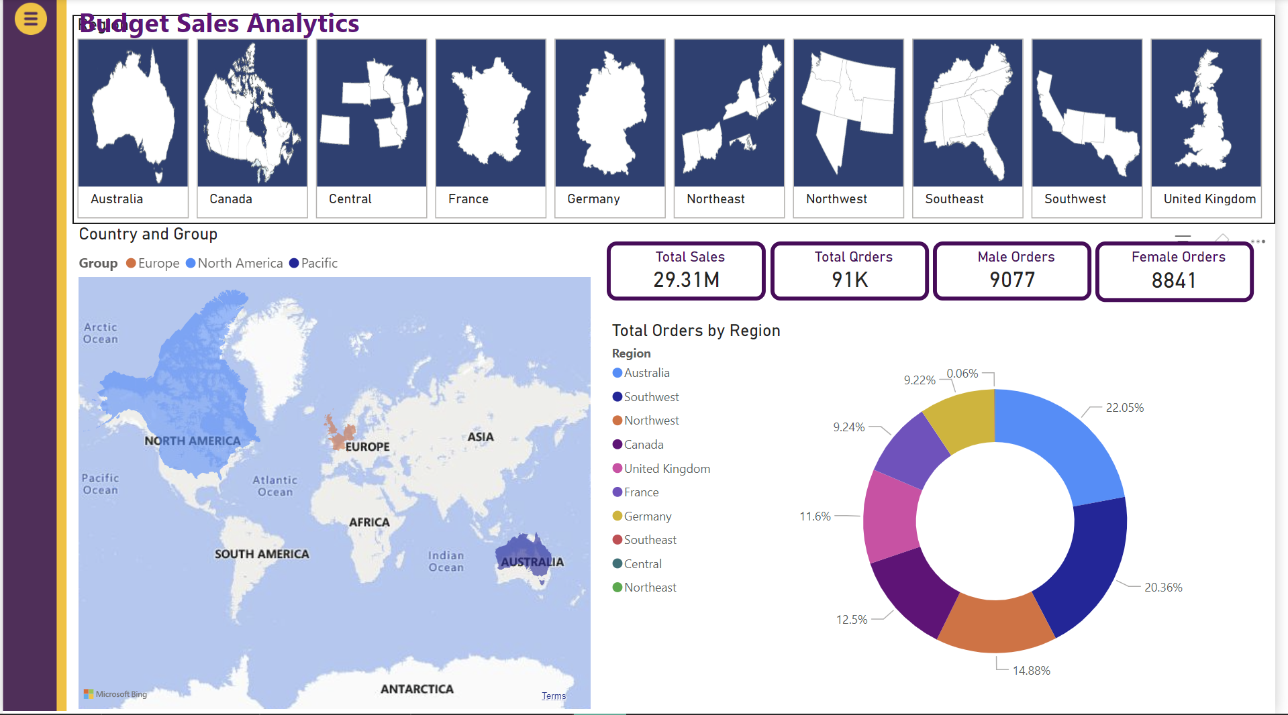
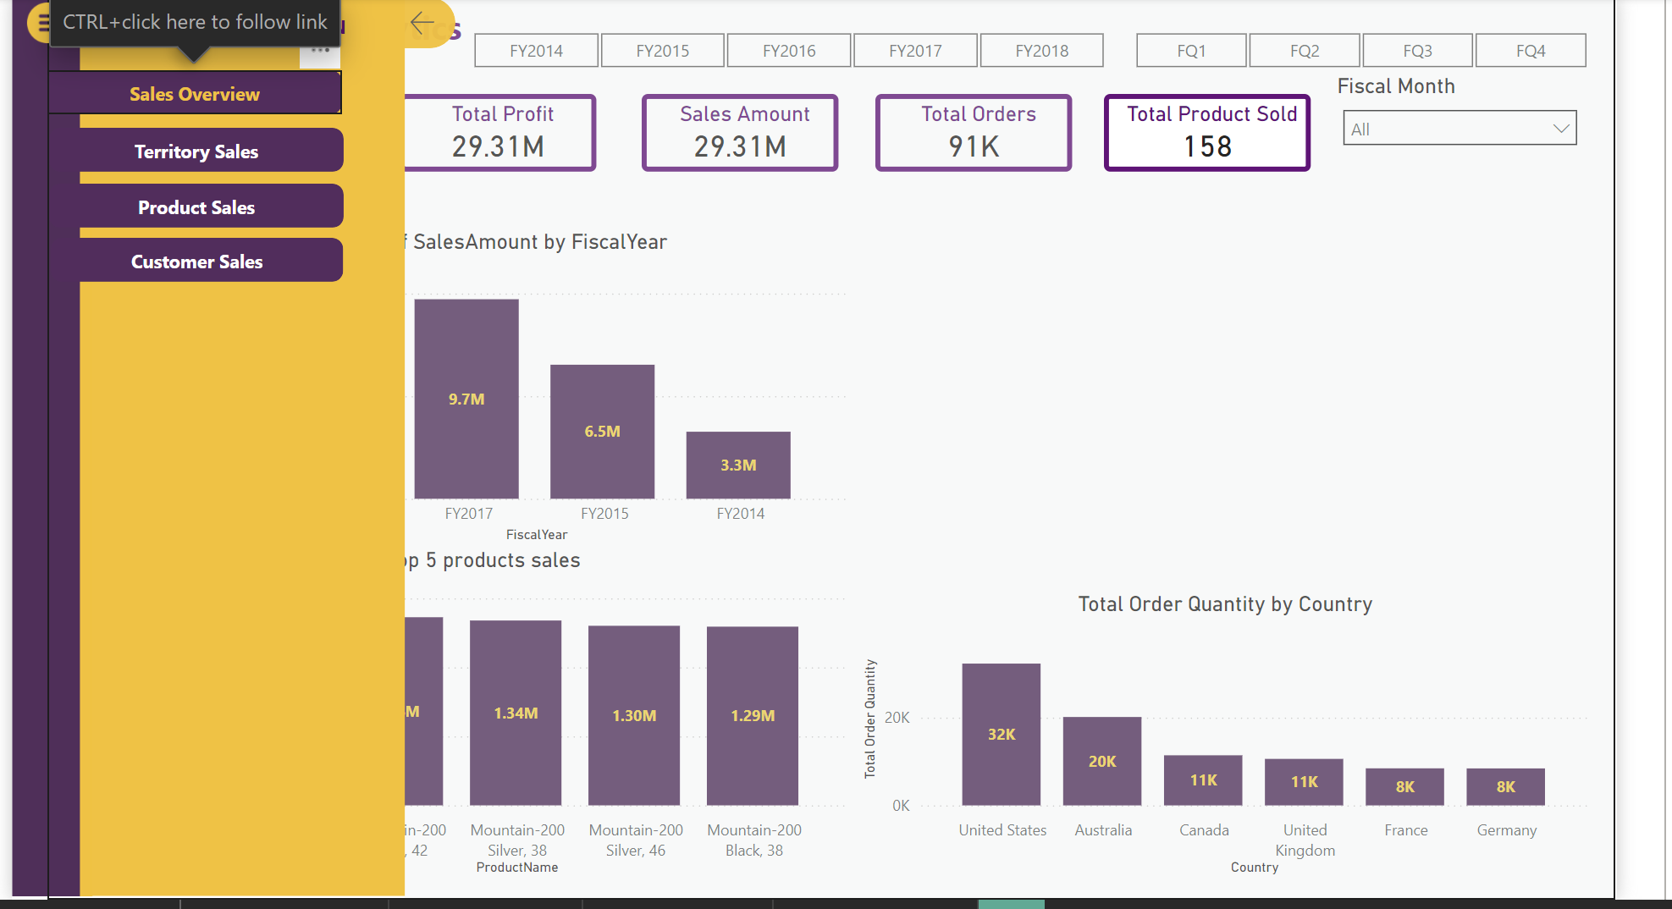
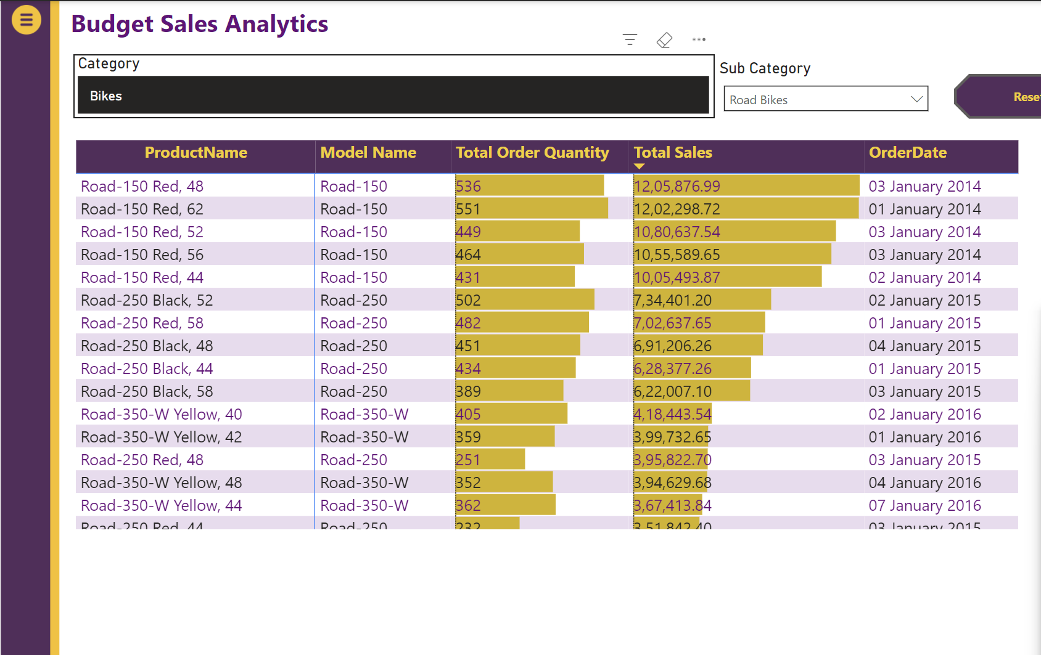
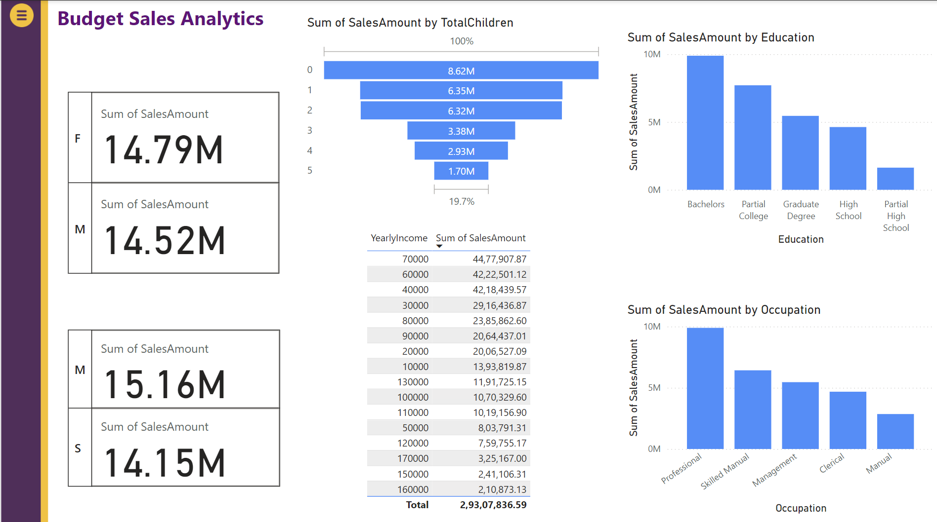
Mock – up Dashboard

Slide 6
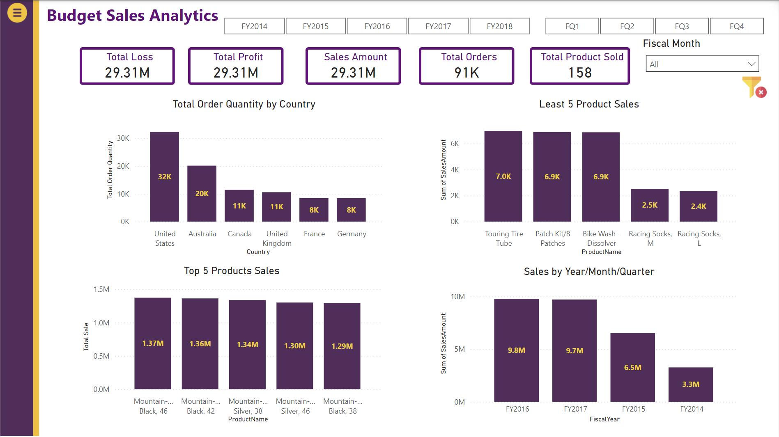
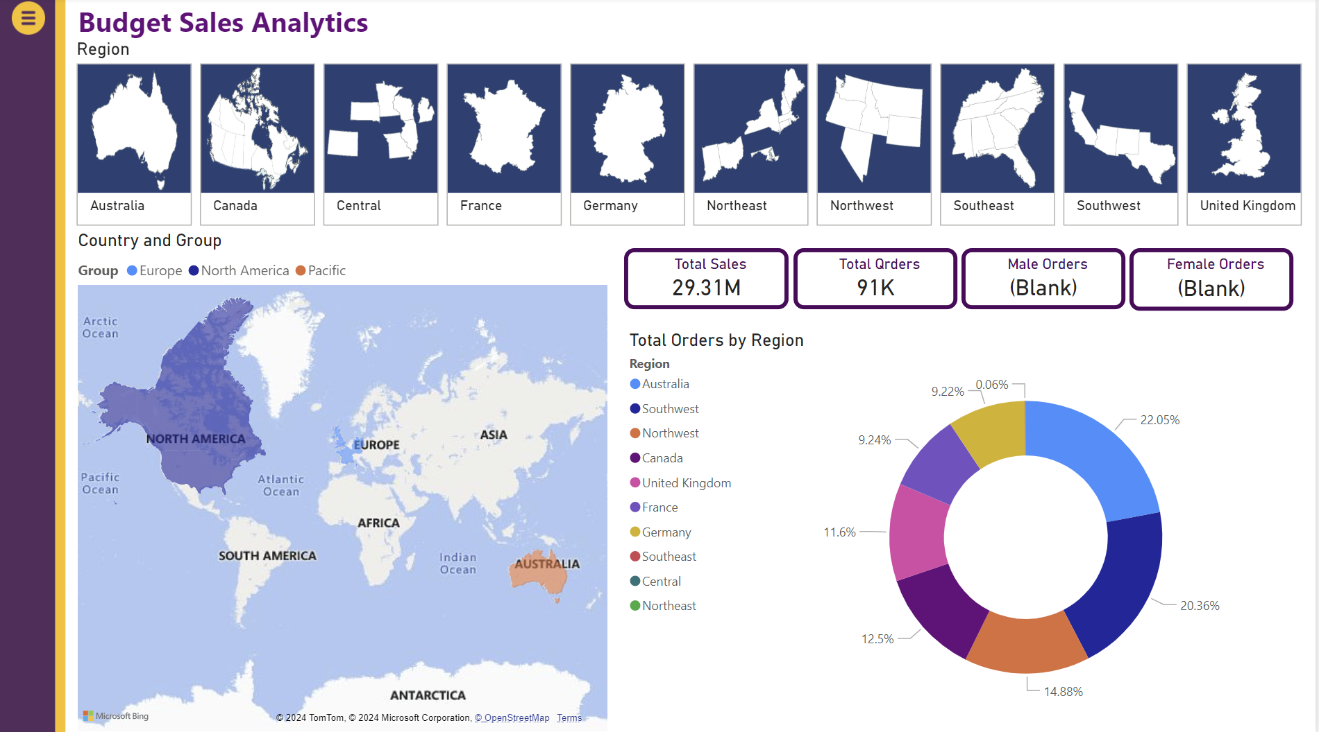
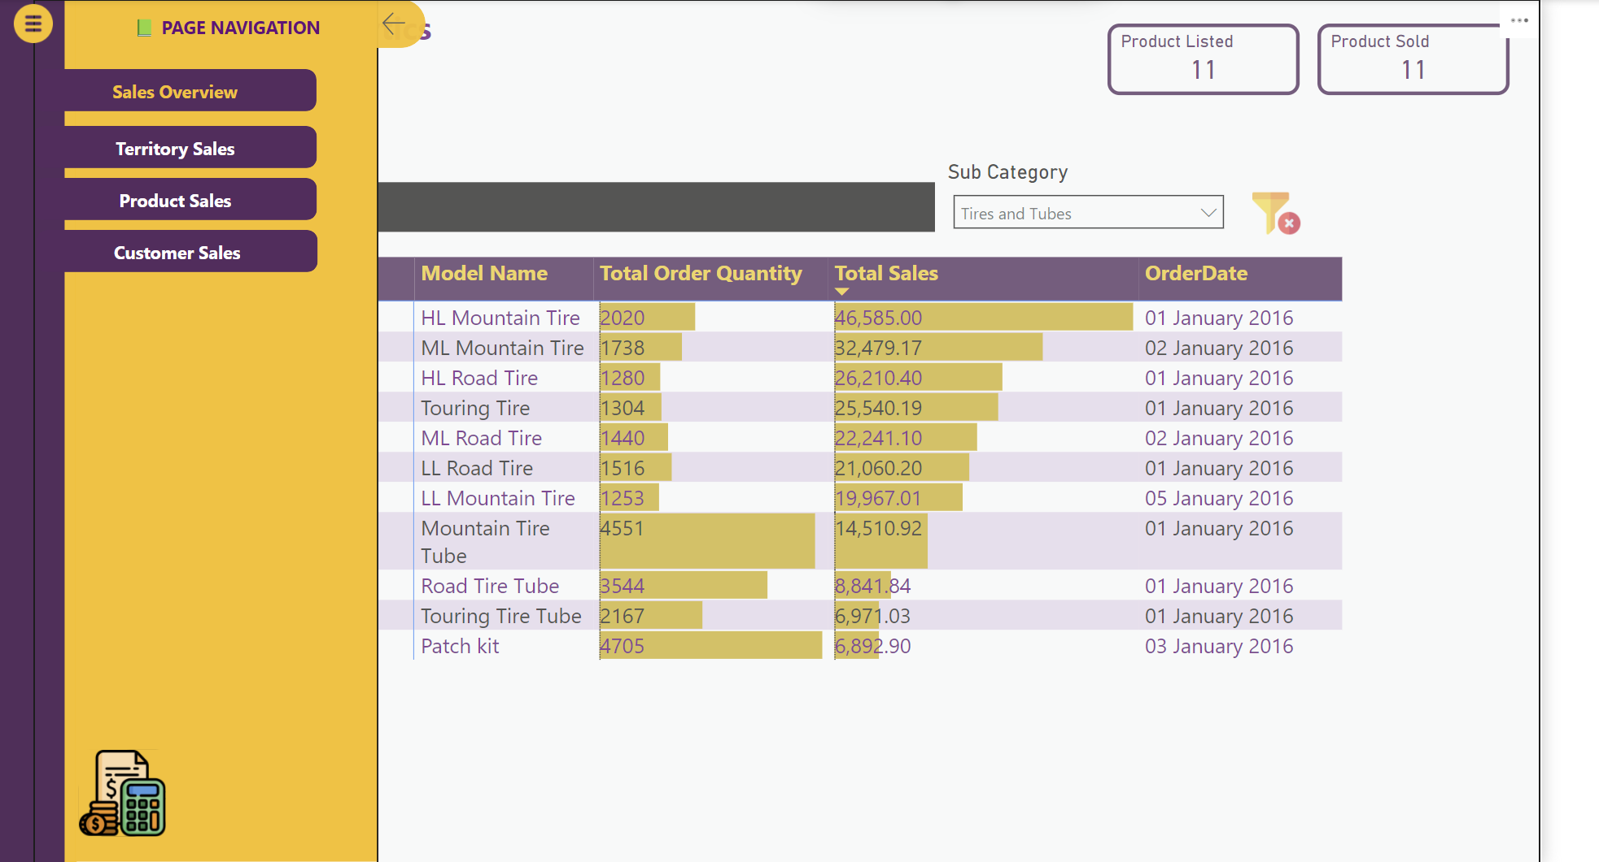
My Design

Slide 7
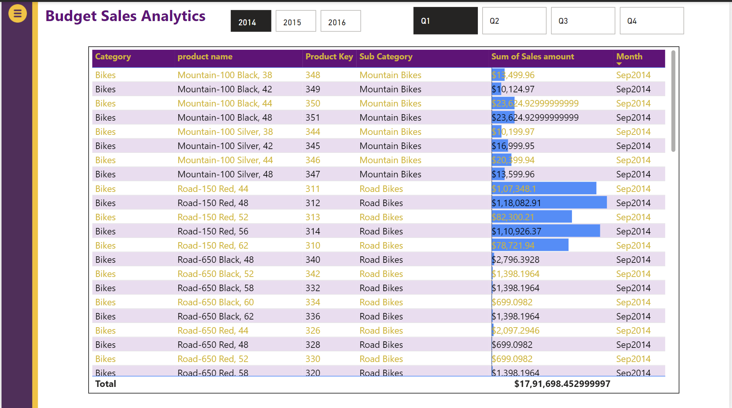
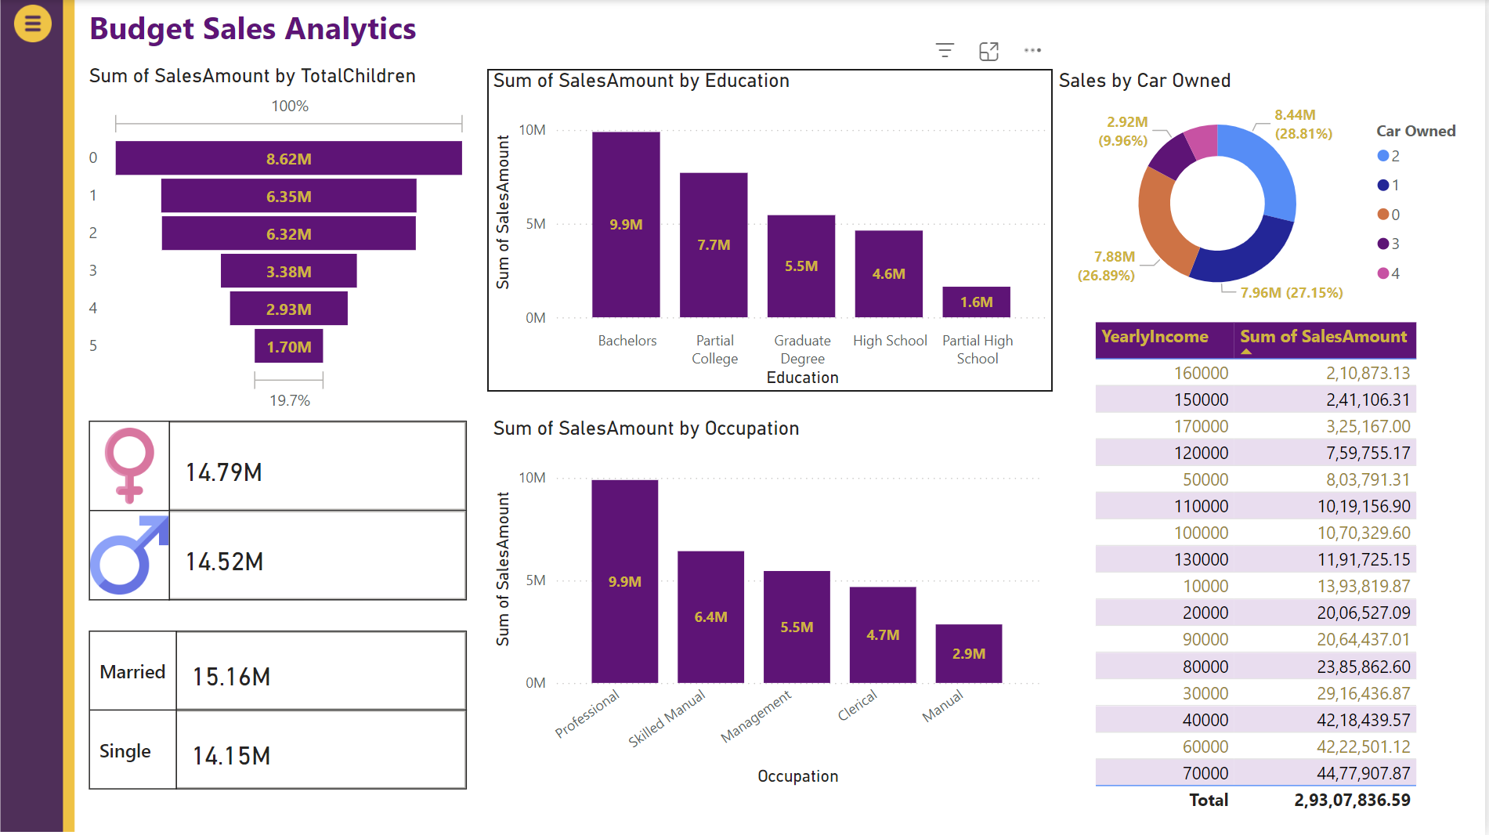
My Design

Slide 8
Thank you

